Slide 1


Student Dataset Analysis
Presented by
Marco Raafat Zakaria
Student at the Faculty of Computers and Artificial Intelligence Cairo University
Email: marco782005@gmail.com

Slide 2
Project Overview
Analyzing Student Data for Insights
This project aims to analyze data from 395 students, uncovering socio-economic influences on education through demographics, family background, social life, and academic performance metrics.

Slide 3
About Dataset
A comprehensive dataset covering:
Demographics: Age, sex, and home address.
Family Background: Parents' education level and their Jobs
Social Life: Weekly study time, free time, alcohol consumption, and romantic relationships.
Academic Performance: Past failures, school support, and final grades (Assignments, Midterm, Final).

Slide 4
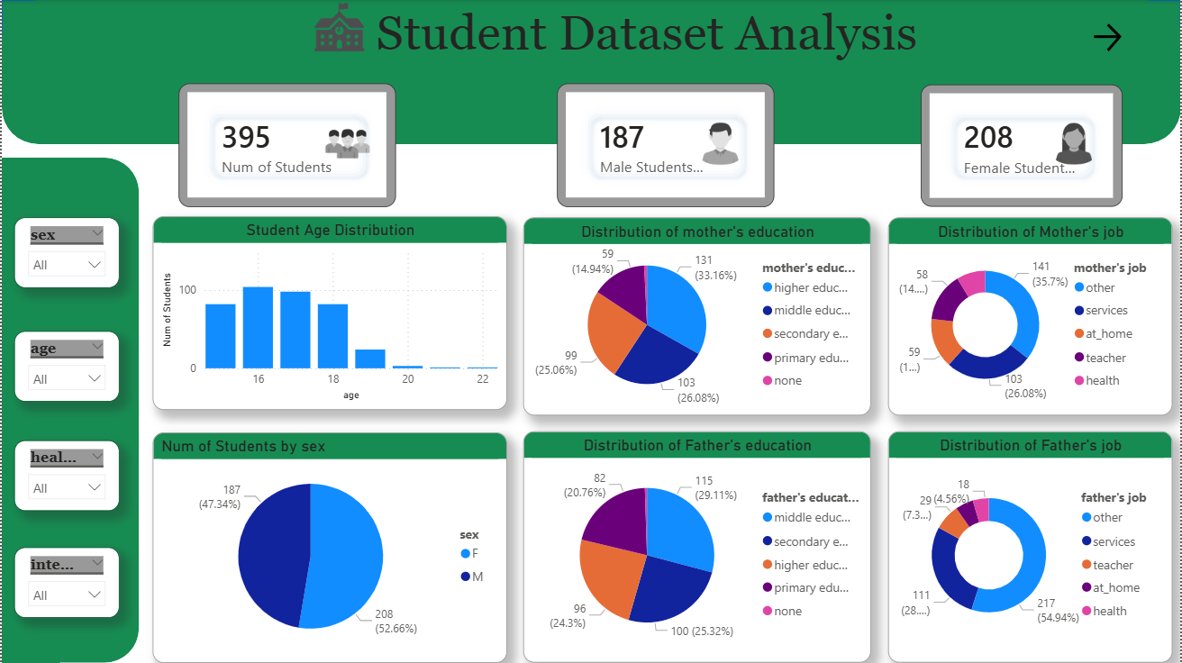

Slide 5
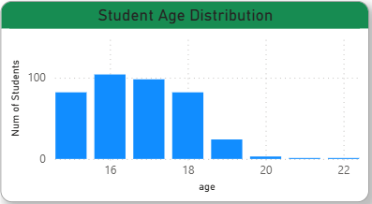
Age Distribution:
The majority of students in the dataset are concentrated between the ages of 15 and 18
Student enrollment peaks at age 16, with more than 100 students.

Slide 6
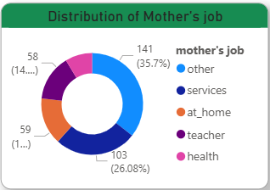
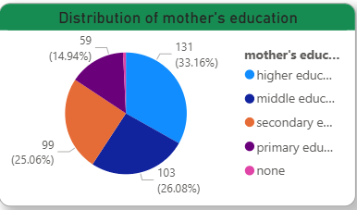
Mother Profile:
Maternal Education : The largest segment of mothers (33.16%) has completed higher education.
Secondary & Middle Education: Approximately 25.06% have secondary education and 26.08% have middle education.

Slide 7
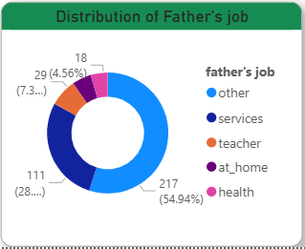
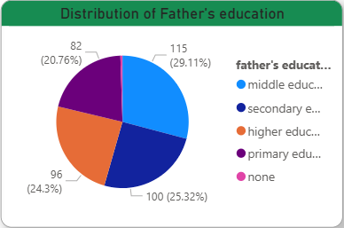
Father Profile:
Fathers' Education : In contrast, the most frequent education level for fathers is middle education, representing 29.11%
While more mothers reached higher education (131) compared to fathers (96)

Slide 8
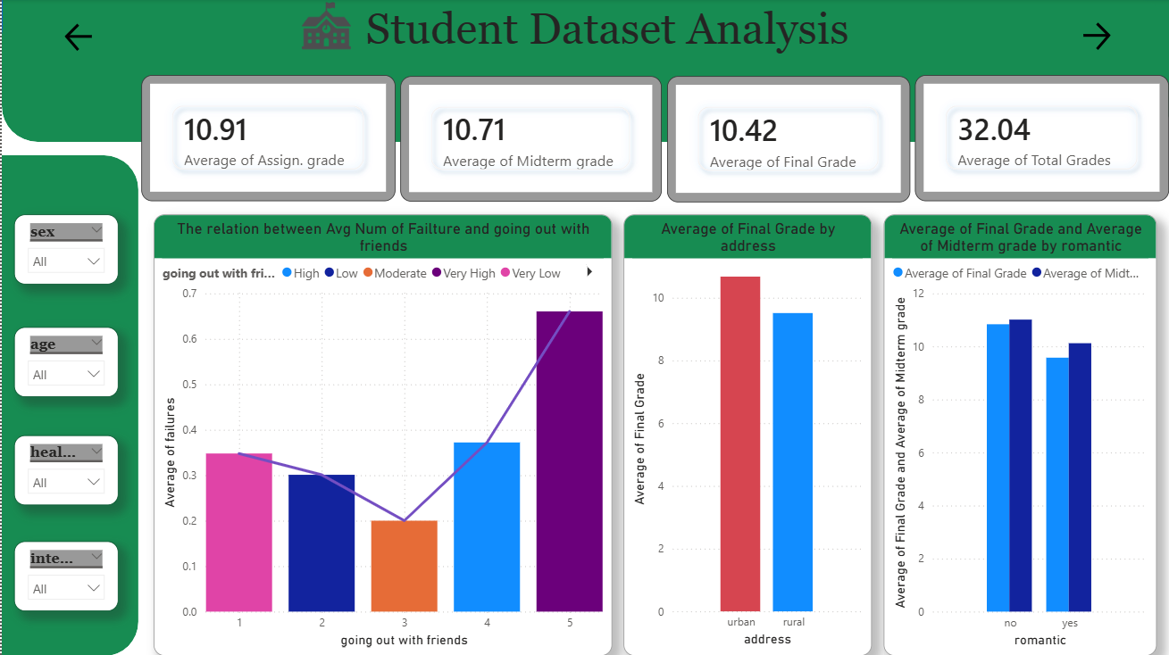

Slide 9




10.91
10.71
10.42
32.04
Average assignment grade
Average midterm grade
Average final grade
Total average grade

Slide 10
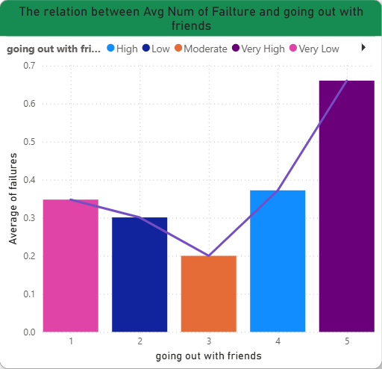
Social Life:
1) The Risk of Over-Socializing: Students who go out with friends at a "Very High" level (Level 5) show the highest average number of failures.
2) The Risk of Isolation: Surprisingly, students who go out "Very Low" (Level 1) are also more prone to failure compared to those with moderate social lives.
3) The "Moderate" Advantage: Students at Level 3 (Moderate) represent the lowest failure rate in the entire dataset, with an average of only 0.2 failures.
4) Conclusion: To achieve high marks, students should moderate their social life. Balance is key; some social interaction is necessary for well-being, but excessive outings directly correlate with academic decline.

Slide 11
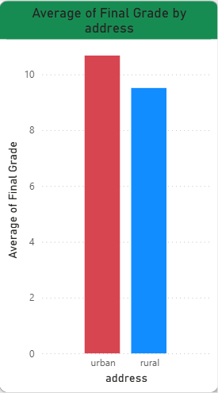
Address:
Location Comparison: Students living in Urban (U) areas have an average final grade of 10.67.
Rural Performance: Students living in Rural (R) areas follow closely with an average final grade of 9.51.
The "Minor Gap" Insight: Although urban students score slightly higher, the difference is only about 1.16 points.
Key Conclusion: This suggests that your living address does not significantly impact your potential for success. A student's location isn't a barrier; other factors like study habits and social balance likely play a much larger role.

Slide 12
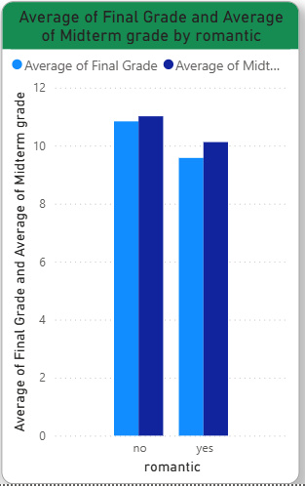
Romance:
The Data Trend: Students not in a romantic relationship show slightly higher average marks.
No Relationship according to final : ~10.84 average.
In a Relationship: ~9.58 average.
Key Insight: Technically, being in a relationship is not a major obstacle to academic success. While it might take up some study time, it does not significantly change the final outcome for most students in this dataset.

Slide 13
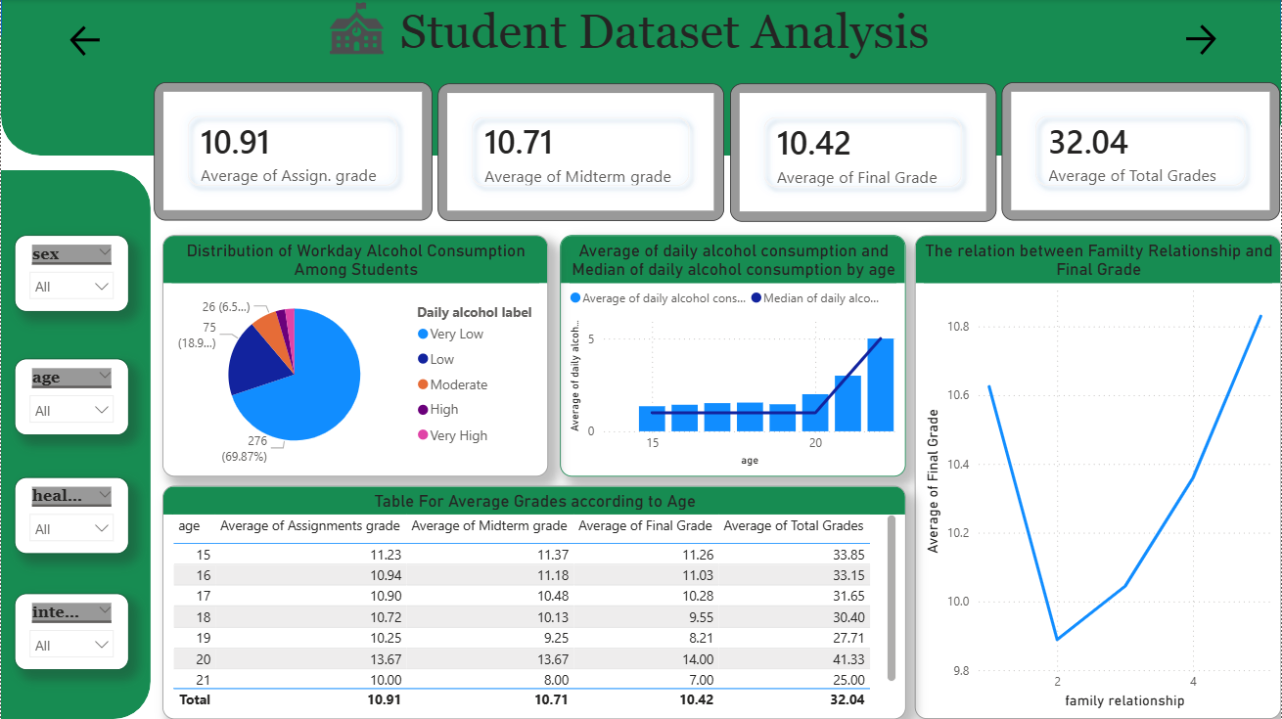

Slide 14
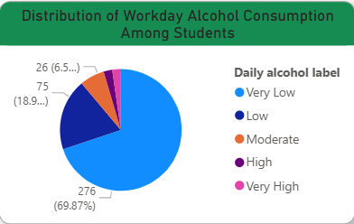
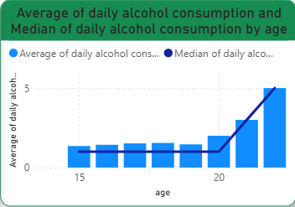
Alcohol Consumption:
The General Rule: Most students (nearly 70%) report "Very Low" alcohol consumption on workdays. The majority of the cohort maintains healthy habits.
The Age Correlation: As we look at the data across the age spectrum, there is a clear upward trend. As age increases, alcohol consumption increases.
The "Peak" Concern: Consumption reaches its highest levels among the oldest students (ages 21 and 22).
Key Finding: While not a problem for the younger majority, substance consumption becomes a significant risk factor as students transition into adulthood.

Slide 15
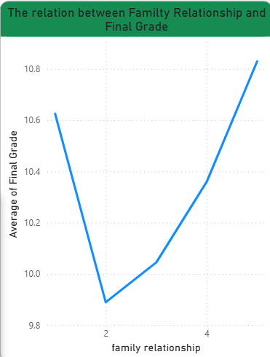
Family relationship:
The Observation: While "Excellent" relationships (Level 5) lead to the highest marks, "Very Bad" (Level 1)
The "Escape Through Study" Theory: In data science, we often see that students in very difficult home environments use school as an "escape." They may spend more time at the library or school to avoid being at home, leading to higher study hours.

Slide 16
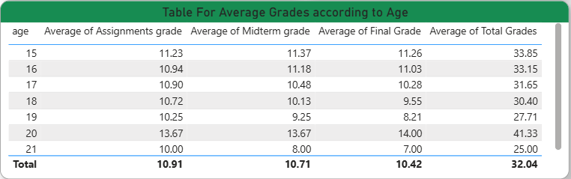
Academic Performance by Age

Slide 17
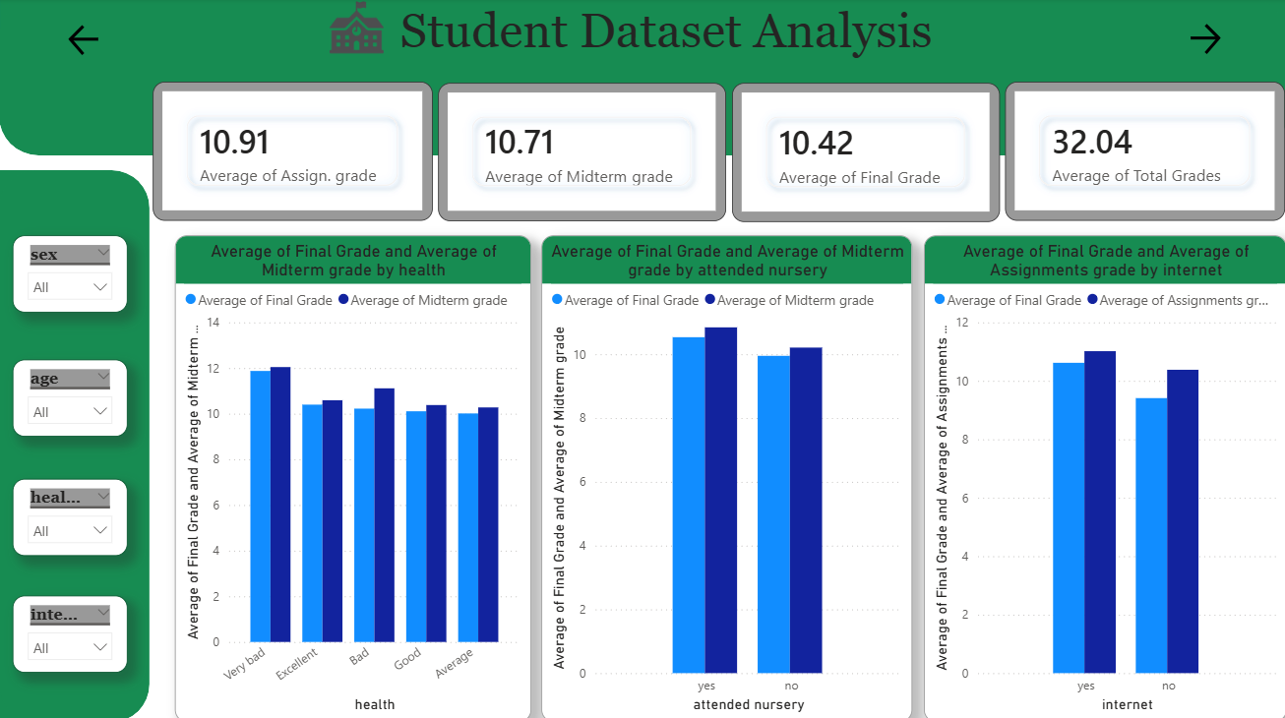

Slide 18
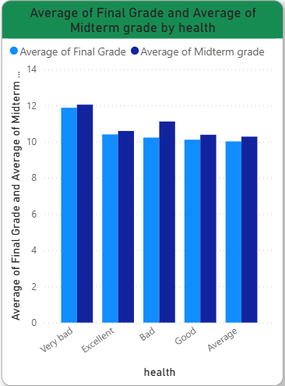
Health:
The "Compensation" Factor: Students with chronic health issues or physical limitations may spend significantly less time on physical activities or going out and more time on sedentary activities like reading and studying.
If a student cannot participate in sports or heavy social events due to health, their "Default" activity often becomes academic work.

Slide 19
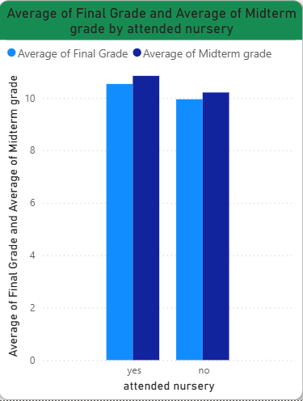
Nursery:
The Finding: Students who attended nursery school before primary education show slightly higher average grades in all periods.
Insight: While early childhood education provides a "head start," the 0.5 point difference suggests that students who missed nursery can almost entirely catch up by the time they reach high school

Slide 20
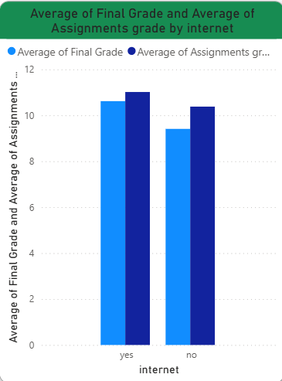
Internet:
The Findings: Students with home internet access significantly outperform those without it.
In modern education, the internet is not a luxury; it is a vital tool for research, assignments, and accessing learning materials

Slide 21
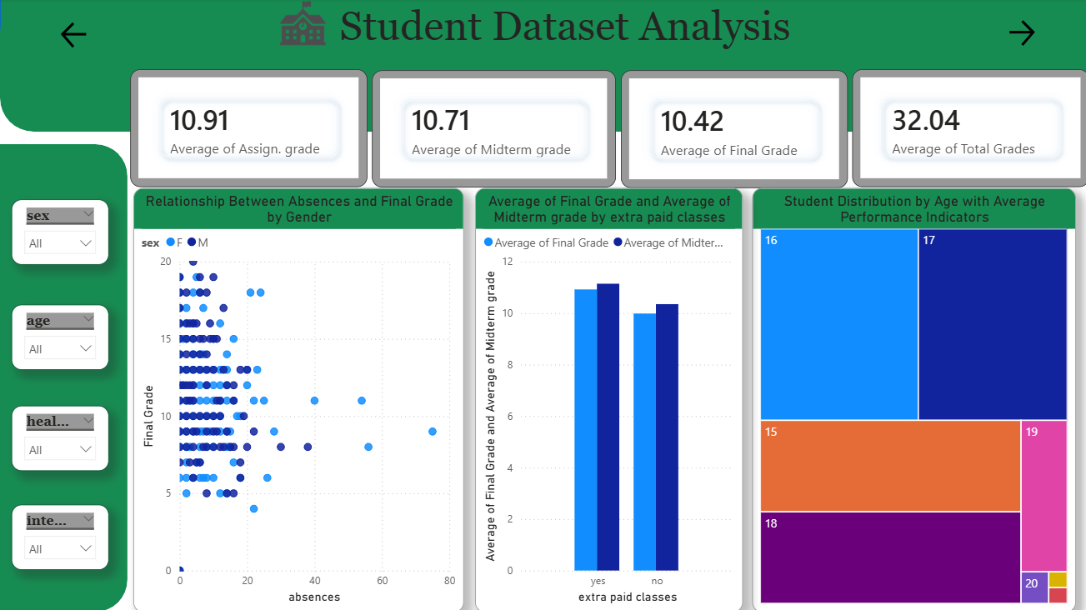

Slide 22
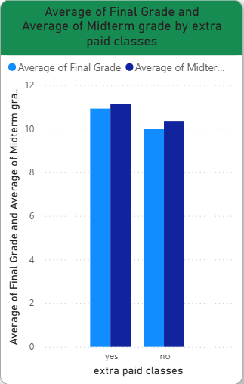
Extra Paid classes:
The Finding: There is a positive correlation between attending extra paid classes and achieving higher academic marks.
Insight: Paid classes provide a safety net and specialized focus that helps students master difficult concepts, which the standard school hours might not fully cover.

Slide 23
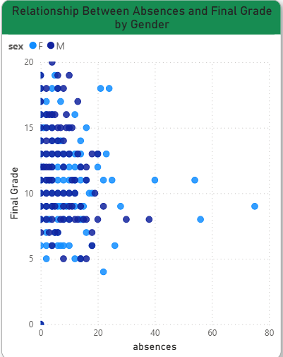
Absence VS Final Grade
The Trend: As the number of absences increases, the average final grade consistently drops.
Attendance is a fundamental "Behavioral Anchor." No matter how much a student studies at home, being physically present in class is irreplaceable for academic success.

Slide 24
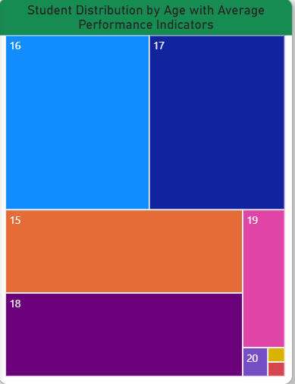
Student Distribution by age:
Cohort Dominance: The vast majority of the students analyzed are aged 16 and 17.
Performance Snapshot (Age 16):
Student Count: 104 students.
Final Grade Average: 11.03
Midterm Grade Average: 11.18
Assignment Grade Average: 10.95
Average of absence: 5.45

Slide 25
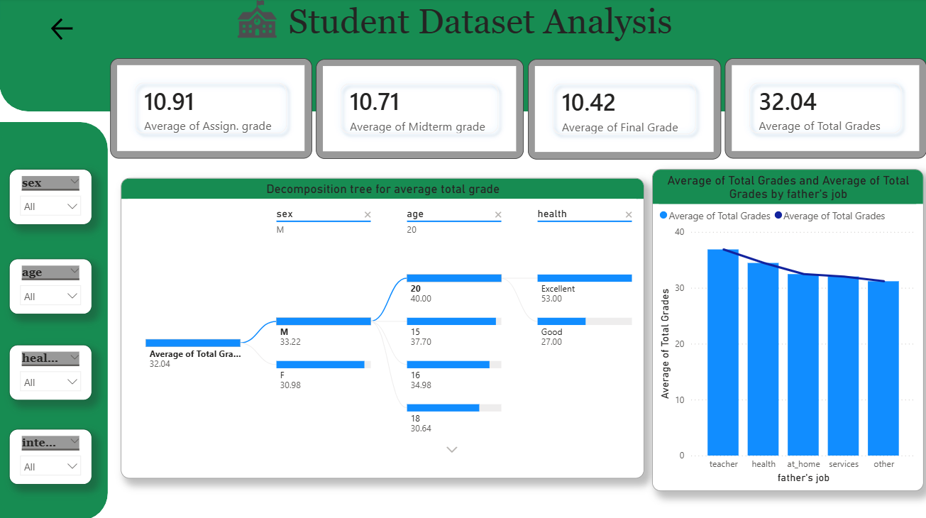

Slide 26
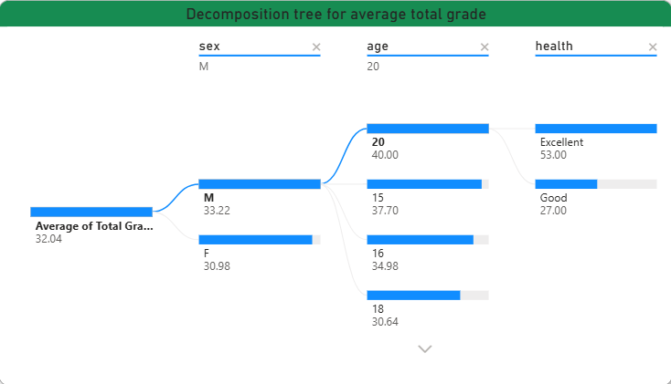
Decomposition tree for average total grade:
Tree that shows the average total Grade by sex, age, health

Slide 27
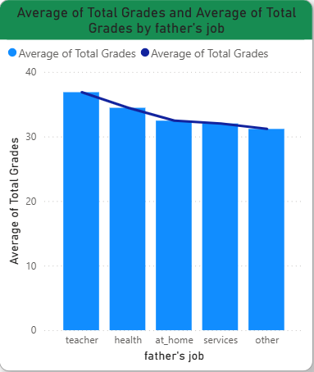
Total Grades by Father’s Job:
The Standout Finding: Students whose fathers work as teachers achieve the highest total grades compared to all other job categories.
The "Academic Home" Theory: A father who is a teacher likely provides direct tutoring, better study resources, and a more structured academic routine at home.

Slide 28
Key Insights
Behavioral Balance:
Essential Foundations:
Maintaining moderate social habits and minimal alcohol consumption lead to success
Academic success is built on home internet access, nursery school attendance, and extra paid classes
The Power of Presence:
Environmental Stability:
There is a direct inverse relationship between absences and grades
strong family relationships and having a father who is a teacher create the most stable environments for reaching peak final grades.

Slide 29


Thank You!
Email
marco782005@gmail.com
linkedin
https://www.linkedin.com/in/marco-raafat-714885304/

